Slide 1
Computer Graphics Project
2D Chess using OpenGL
Rhitwik Saha (18075048)

Slide 2
Open GL
OpenGL(Open Graphics Library) is a standard specification defining a cross language cross platform API for writing applications that produce 2D and 3D computer graphics.
The interface consists of over 250 different function calls which can be used to draw complex 3D scenes from simple primitives.

Slide 3
Project Goal
The aim of the project is to successfully implement all the functionalities of a 2D chess game, using OpenGL.
The pieces have been formed using primitive shapes by varying their scales.

Slide 4
Scope
The Project is developed in Sublime Text IDE. It has been implemented on Ubuntu Platform.
The 2D graphics package designed here provides an interface for the users for handling the display of chessboard and different chess pieces.
The mouse is the main and only input device used.

Slide 5
Requirement Specifications
HARDWARE SPECIFICATION:
4GB of RAM
150MB of hard disk space required (for installation of Software)
SOFTWARE REQUIREMENT:
Development Tool: LINUX(Ubuntu 18.04 LTS)
Language: C/C++
IDE: Sublime Text
Library: OpenGL

Slide 6
Basic Design
The project comprises of two section:
Graphic UI: This renders with the graphical user interface, of the chessboard and the chess piece along with a display board on the right hand side of the screen.
Logic: This serves as the logic behind the possible moves that a chess piece can perform, taking cases for check, illegal moves and checkmate.

Slide 7
Design(1)
I have incorporated several inbuilt OpenGL functions in the Graphic UI file.
Header files used:
#include<stdio.h> : This is C library for standard input and output and display, and general purpose functions.
#include<GL/glut.h> : This header is included to read the glut.h, gl.h, glu.h.
#include<math.h> : This is a C library used for performing certain mathematical operations.
#include<string.h> : This is a C library used to perform manipulation on character array.
#include<vector> : This is a C++ library used to perform manipulation on vector arrays, that I have used in the logic part of the project.

Slide 8
Design(2)
The following functions have been used which enables the rendering of chess pieces and chessboard with different specific colors and the display box.
glColor3ub(...) : sets the current color (takes rgb values)
glVertex2i(...) : specifies a vertex (takes x,y coordinate)
glBegin(...) and glEnd(...) : delimits the vertices between them.
glLineWidth(...) : specifies the width of rasterized lines
glPointSize(...) : specifies the diameter of rasterized points.
glRasterPos2f(...) : specifies the bottom left position of text.
glutBitmapCharacter(...) : displays the character.

Slide 9
Design(3)
In the logic portion of the project, I have implemented several method functions for each chess piece.
It includes all the current possible moves for the current player for all his chess pieces.
I have also implemented the code for check and checkmate conditions for every chess piece.

Slide 10
User Interface
The mouse is the major and only user input used here:
Left Button: Allows the user to select a chess piece and chess square.
Right Button: Allows the user to undo move.

Slide 11
SnapShots
Snapshot 1: In this snapshot the initial structure and arrangement of the chess pieces are shown along with a display box on the right which will show the alerts during the game.
Snapshot 2: in this snapshot an in-game screenshot has been shown where BLACK king is CHECKED with WHITE queen, which is displayed on the display box on the right.

Slide 12
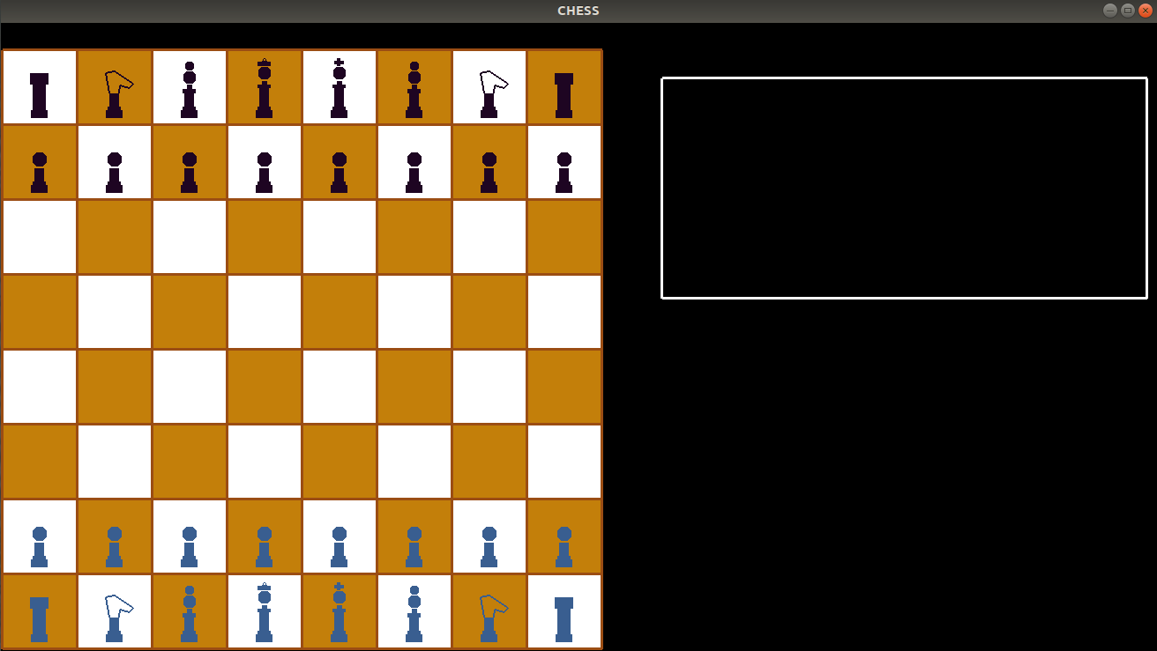
Snapshot 1

Slide 13
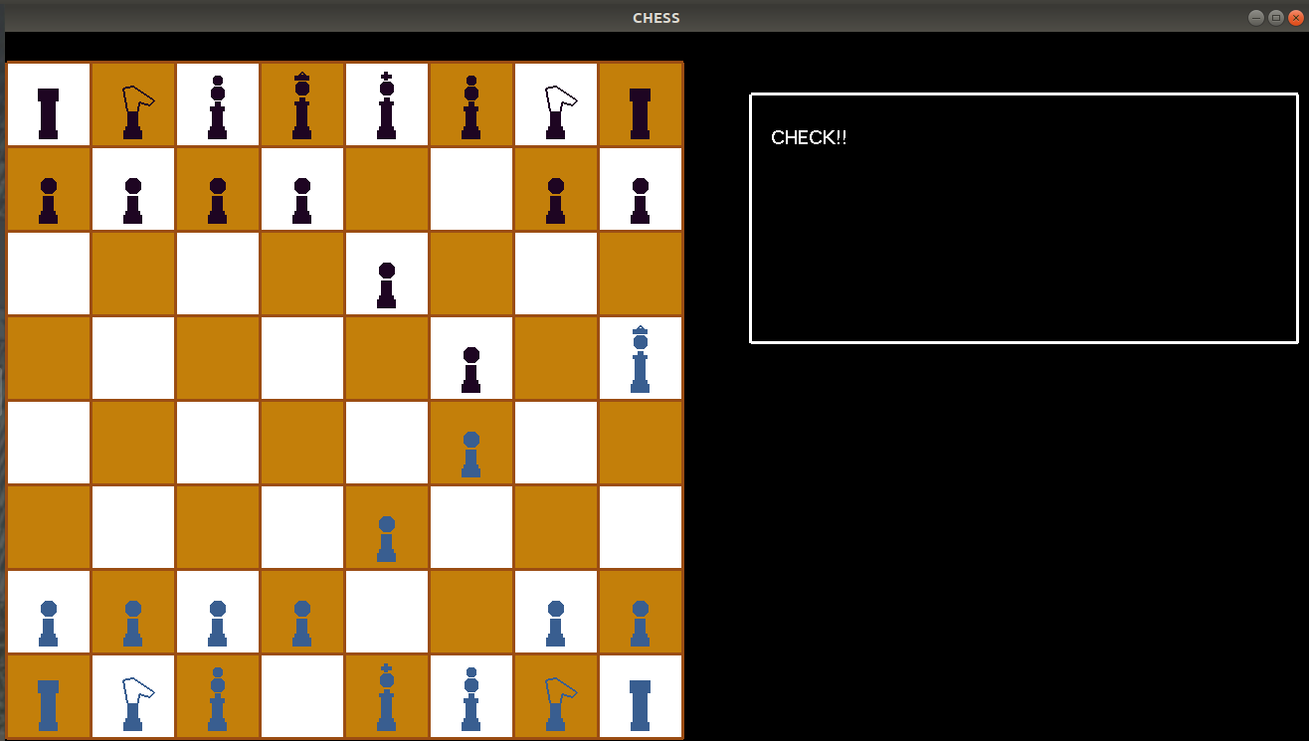
Snapshot 2

Slide 14
Future Advancements
3D implementation of this game can be done, with more advanced structure formation of the chess pieces, using primitive shapes like, cones, spheres, cuboids, etc.
AI can be introduced in this which will play according to designated difficulty.

Slide 15
THANK YOU!

